Slide 1
Delta Debugging
Politecnico di Milano
An advanced debugging technique
Authors:
Carlo Curino, Alessandro Giusti
AAIS 05
Curino, Giusti

Slide 2
Delta Debugging
An advanced debugging technique
Simplifying and Isolating
Failure-Inducing Input
AAIS 05
Curino, Giusti

Slide 3
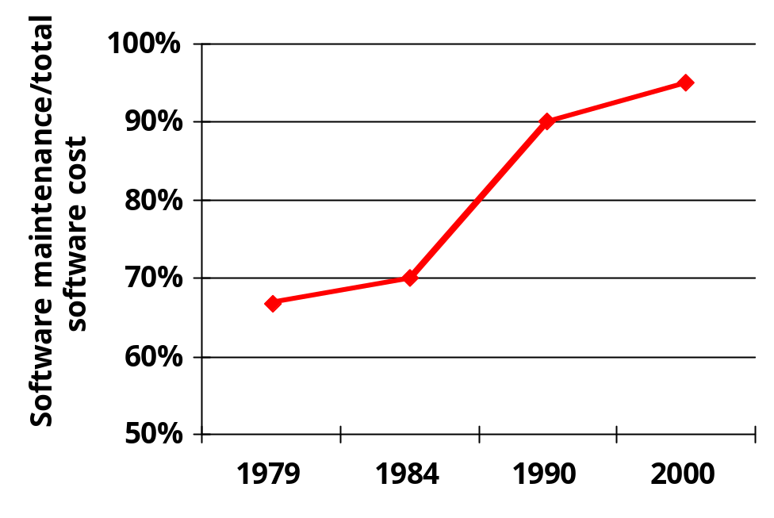
Motivations
Reducing faults:
  50%-80% of total cost
Debugging:
  One of the hardest, yet least systematic activities of software engineering
  most time-consuming
Locating faults:
  most difficult
AAIS 05
Curino, Giusti

Slide 4
Causes and Effects
A cause is an event preceding another event without which the event in question (the effect) would not have occurred.
A defect is propagated and causes the failure if the failure would not have occurred without the defect
Not every defect causes a failure
The process tests for specific failure
Debugging = search for a defect that causes the failure

Slide 5
Overview
Which problems are solved by Delta Debugging
Four solutions: a common approach
Simplifying failure-inducing input
Isolating failure-inducing thread schedule
Identifying failure-inducing changes in the code
Isolating Cause-Effect Chains
AAIS 05
Curino, Giusti

Slide 6
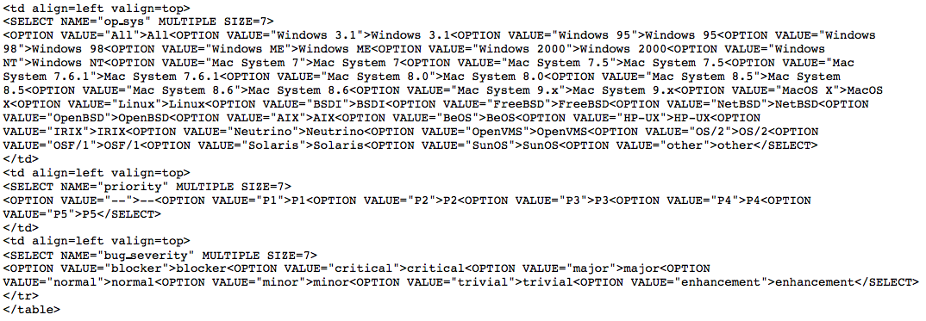
Failure-inducing input
This HTML input makes Mozilla crash (segmentation fault). Which portion is the failure-inducing one?
AAIS 05
Curino, Giusti

Slide 7
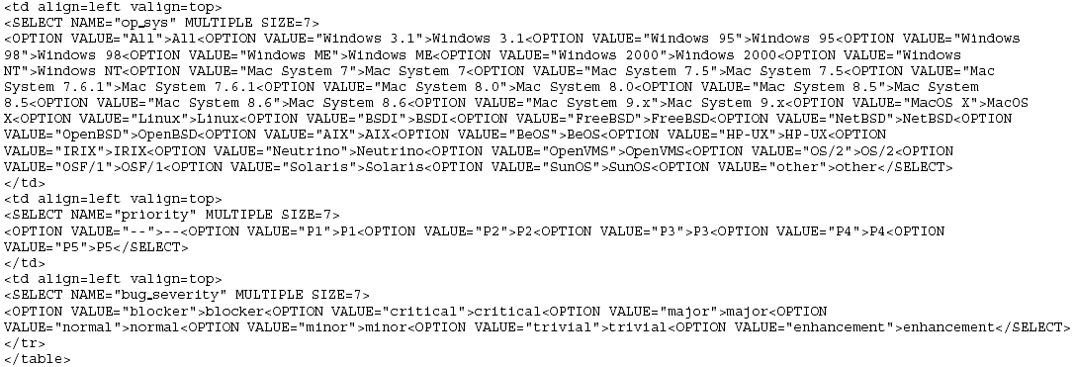
Mozilla Crash
What is relevant here?

Slide 8
Mozilla Crash
What is common across several similar reports

Slide 9
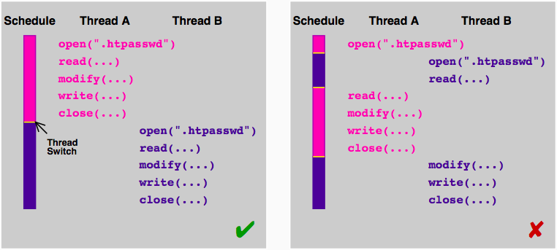
Thread scheduling
The result of a multithread program seems not deterministic. Why it happens?
AAIS 05
Curino, Giusti

Slide 10
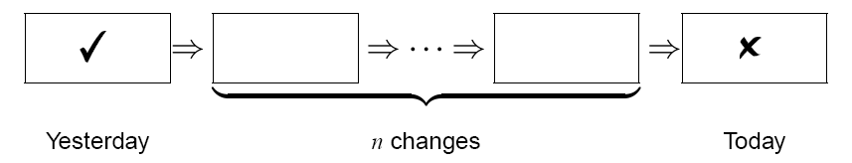
Code changes
A given revision of a program behaves correctly. The next one does not.
Find which of the changes in the code causes the problem.
AAIS 05
Curino, Giusti

Slide 11

Code changes
The old version of GDB works with DDD, the new one doesn’t!
178.000 lines of code have been modified between the two versions where’s the bug?
AAIS 05
Curino, Giusti

Slide 12
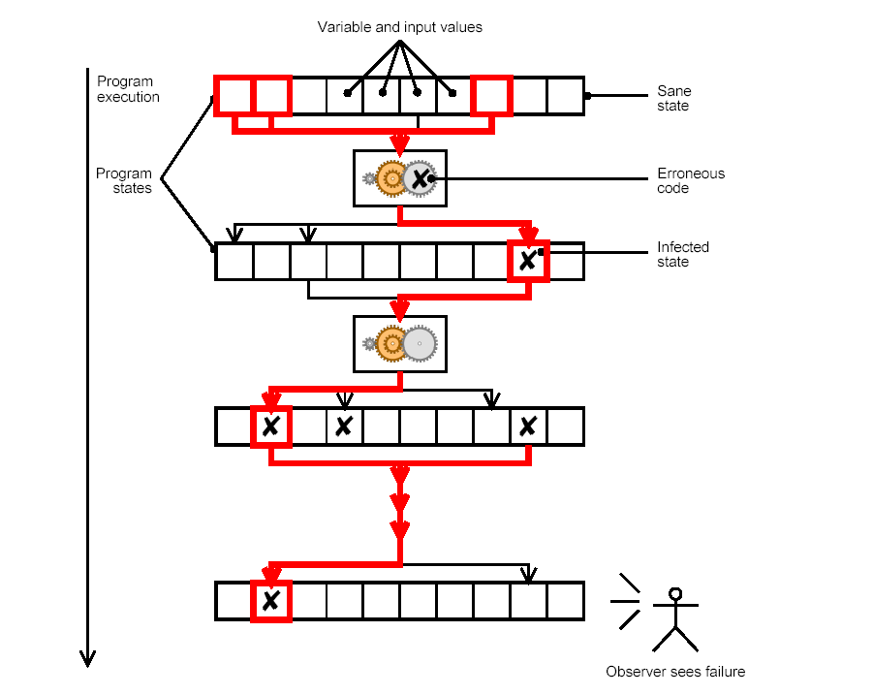

Cause-effect chain
Which part of the program state is involved in the failure?
AAIS 05
Curino, Giusti

Slide 13
Four solutions: a single approach
The underlying problem is:
  Find which part of something determines the failure
So a common strategy can be applied:
Divide et impera applied to deltas between:
  Working and failing Inputs
  Working and failing code versions
  Working and failing threads schedules
  Working and failing program states
This allows:
Efficient and automatic debugging procedure
AAIS 05
Curino, Giusti

Slide 14
Common terminology
A test case can either:
  Fail
    (The failure shows up)
  Pass
    (program runs properly)
  Be Unspecified
    (different problems arise)
Delta debugging Algorithms iteratively:
  Apply changes (to input, code, schedule or state)
  Run tests
AAIS 05
Curino, Giusti

Slide 15
Common terminology (2)
Concept of difference:
  A really general delta between something in 2 test cases
Examples:
  Difference in the input: different character (or bit) in the input stream
  Difference in thread schedule: difference in the time a given thread switch is performed
  Difference in the code: different statement in 2 version of a program
  Difference in the program state: different values of the internal variables of a program
AAIS 05
Curino, Giusti

Slide 16
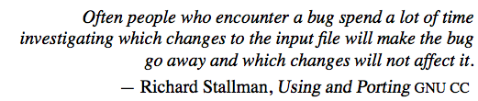
Simplifying Failure-inducing input
AAIS 05
Curino, Giusti

Slide 17
Minimizing vs Isolating
Minimizing (ddmin algorithm):
  Slower
  More human friendly
Isolating (dd algorithm):
  Generalization of the ddmin algorithm
  Faster
  Good to generate the input of the cause-effect chain DD
AAIS 05
Curino, Giusti

Slide 18
Unresolved Test Outcomes
1
3 ?
4 ?
2
Problem: what to do if the both test cases are unresolved?

Slide 19
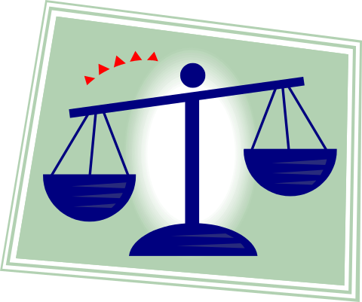
Change Granularity
 | Increase Granularity of test case | Decrease Granularity of test case
Failure of the test case | More chances | Less chances
Progress of the search | Slower, Reduced by amount < ½ | Faster, Reduced by amount > ½

Slide 20
General DD Algorithm
Basic idea:
Start with few & large changes first
If all alternatives are unresolved, apply more & smaller changes.
∆1
∆2
∆1
∆2
∆1
∆2
∆3
∆4
∆5
∆6
∆7
∆8
∆1
∆2
∆3
∆4
∆5
∆6
∆7
∆8

Slide 21
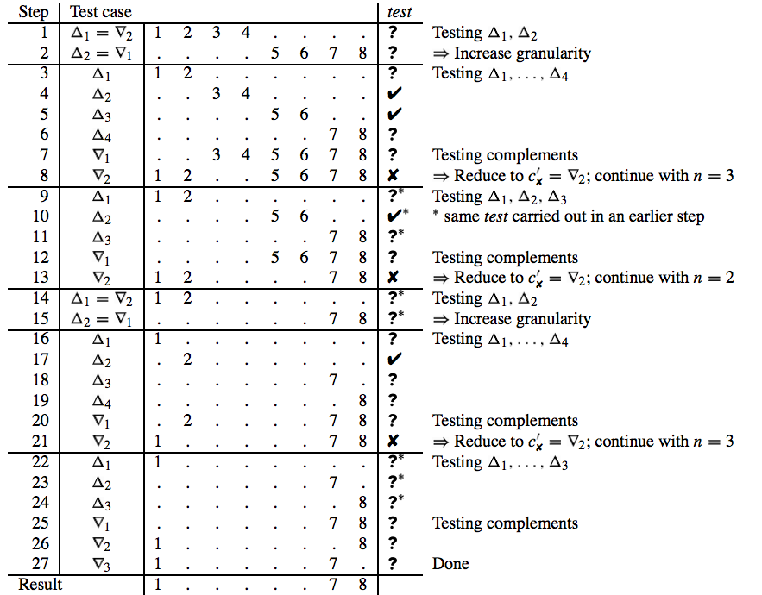
Minimizing: didactic example
AAIS 05
Curino, Giusti

